Slide 1

VEL TECH HIGH TECH Dr. RANGARAJAN Dr. SAKUNTHALA ENGINEERING COLLEGE An Autonomous Institution
Department of Computer Science and Engineering
Mini Project Review
A Study on Voice-Activated Email for People with Visual Impairments
AKALYA.S (VH-12292) SUPERVISOR:
HARINIPRIYA.V (VH-12338)
Dr.J.SENTHIL MURUGAN
Associate Professor
III YEAR ,COMPUTER SCIENCE AND ENGINEERING CSE

Slide 2
ABSTRACT:
Artificial intelligence has the potential to revolutionize the way that visually impaired individuals interact with technology. With this in mind, a voice-based email system for visually impaired individuals has been proposed as a solution to provide a convenient and accessible way of managing email. The system leverages advanced Natural language processing (NLP)and Automatic Speech Recognition(ASR) technologies to convert spoken commands into email actions. The system supports voice commands for dictating emails, text-to-speech functionality for reading emails, and speech-to-text for writing mails, navigating the inbox, giving the count of unseen mails and managing emails. This system is designed to be user-friendly, intuitive, and accessible, ensuring that blind individuals can easily navigate and use it with ease. Implementation of this system has the potential to greatly improve the daily lives of visually impaired individuals by providing a more convenient and accessible way to manage emails. This project presents a novel Al-powered voice-based email system designed specifically for blind individuals.

Slide 3
INTRODUCTION:
Voice-based email systems provide an essential tool for blind and visually impaired individuals, enabling them to access and manage emails through voice commands. By integrating technologies like speech recognition and text-to-speech, these systems allow users to send, receive, and organize emails without relying on visual interfaces. This approach ensures greater accessibility and independence in digital communication. The system also includes advanced information retrieval processes, allowing users to easily search and filter emails using voice commands. Overall, voice-based email systems offer an inclusive solution, empowering visually impaired users to engage with their digital correspondence effectively.

Slide 4
S.N0 | YEAR | TITTLE&AUTHOR | DESCRIPTION | METHODOLOGY
1 | 2023 | VOICE-BASED EMAIL SYSTEM FOR THE VISUALLY CHALLENGED SATYA PRAKASH, KARTIKEY AGRAWAL, SIDDHARTH DOSAJ, SHATAKSHI SINGH | Voice-Based Email System designed for visually challenged individuals, addressing the accessibility gap in email communication. This system allows visually impaired users to send and receive emails independently through voice commands. It integrates advanced technologies such as voice recognition, text-to-speech (TTS), and speech-to-text (STT), providing a user-friendly interface that transforms spoken words into written text and enables interaction with the email system through voice commands. | Requirements Gathering: Identify needs of visually impaired users through interviews and questionnaires. Design & Interface Planning: Develop an accessible interface with high contrast, large buttons, and intuitive navigation. Speech Recognition Integration: Implement a reliable speech-to-text API for accurate voice command processing. Accessibility Features: Ensure compliance with accessibility guidelines, including haptic feedback and gesture controls. Email Integration: Connect with email APIs like IMAP/SMTP for voice-controlled email management. Security & Privacy:Apply encryption and voice authentication for secure access. Testing & Iteration:Conduct user testing with visually impaired participants, refining the system based on feedback.

Slide 5
S.N0 | YEAR | TITTLE&AUTHOR | DESCRIPTION | METHODOLOGY
2 | 2023 | Voice based E-mail for the Visually Impaired Shubham Dakhare, Nakul Patil, Devashish Bisen, Dhanashri Shinde, Mrs. Surbhi Khare | The paper discusses a voice-based email system designed to assist visually impaired individuals in accessing and managing emails. The primary focus of this system is to allow users to send and receive emails through voice commands, eliminating the need for visual interaction with the interface. The system converts voice inputs into text and text into voice outputs, making it accessible for users with visual impairments. It also aims to provide a secure environment by incorporating user authentication features. | Speech Recognition: Uses AI to convert spoken commands into text. User Interface: A simple, voice-driven UI with a large button to start voice commands. Database: Stores user details and emails securely. Email Handling: Uses SMTP for sending and IMAP/POP for receiving emails. Text-to-Speech: Converts emails into speech for users. Security: Ensures user authentication via voice-based verification.

Slide 6
S.N0 | YEAR | TITTLE&AUTHOR | DESCRIPTION | METHODOLOGY
3 | 2023 | Comparative Analysis of VPN Protocols at Layer 2Focusing on Voice Over Internet Protocol SETIYO BUDIYANTO AND DADANG GUNAWAN 2 | A comparative analysis of Layer 2 VPN protocols (like PPTP, L2TP, OpenVPN) for VoIP focuses on their impact on call quality. Key factors include latency, jitter, bandwidth, and encryption overhead, which affect the clarity and reliability of voice transmissions. | Select Protocols: Choose Layer 2 VPNs like PPTP, L2TP, and OpenVPN. Set Up Test Environment: Simulate VoIP calls over VPNs in a controlled network. Measure Key Metrics: Focus on latency, jitter, packet loss, bandwidth usage, and encryption overhead. Run Tests: Conduct VoIP calls under different conditions. Analyze Data: Compare performance across protocols to identify the most efficient for VoIP.

Slide 7
S.N0 | YEAR | TITTLE&AUTHOR | DESCRIPTION | METHODOLOGY
4 | 2021 | Usage-Based Learning in Human Interaction With an Adaptive Virtual Assistant Clément Delgrange, Jean-Michel Dussoux, and Peter Ford Dominey | The paper explores a usage-based learning approach for human interaction with an adaptive virtual assistant. Unlike traditional systems where responses are pre-defined, this assistant learns through natural language instructions and user demonstrations. Grounded in developmental theories of human language acquisition, the system uses primitive perceptual and motor commands to map natural language expressions to executable actions. | Grounding Language in Primitives: The assistant learns from user demonstrations and natural language instructions, creating mappings between commands and procedural knowledge. One-Shot Learning: Demonstrated tasks are stored and generalized for future use with variable arguments, allowing rapid adaptation. Compositional Learning: The system builds new complex tasks by combining previously learned actions and procedures, facilitating adaptability across domains like email management and Wikipedia browsing.

Slide 8
S.N0 | YEAR | TITTLE&AUTHOR | DESCRIPTION | METHODOLOGY
5 | 2022 | A Voice Controlled E-Commerce Web Application Mandeep Singh Kandhari , Farhana Zulkernine | The document explores the development of a voice-controlled e-commerce application utilizing IBM Watson's Speech-to-Text (STT) and Text-to-Speech (TTS) technologies. This system aims to enhance accessibility for users, especially those with disabilities, by allowing natural language voice commands to perform various e-commerce functions such as browsing, searching, and purchasing. The application integrates advanced NLP and deep learning methods to improve interaction and usability, creating a seamless experience for users. | Speech Recognition and Processing: Voice commands are converted into text using Watson STT, where keywords are extracted to trigger specific functionalities. Natural Language Interaction: TTS is used for voice feedback, ensuring effective communication with users. Frontend and Backend Integration: React.js and Express.js are used for frontend and backend development, while MongoDB serves as the database. Keyword Matching and Execution: The application identifies keywords within user commands to execute predefined actions or provide feedback if the action is not recognized.

Slide 9
EXISTING SYSTEM:
Screen Readers:
Software like JAWS (Job Access With Speech), NVDA (NonVisual Desktop Access), and VoiceOver (for MacOS and iOS) are used to read text aloud.
Voice Assistants:
General-purpose virtual assistants like Google Assistant, Siri, and Alexa are used to perform basic email tasks through voice commands.
Accessibility Features in Email Clients:
Some email platforms like Gmail and Outlook provide accessibility modes optimized for screen readers.
Keyboard shortcuts allow users to navigate email interfaces without relying on a mouse.

Slide 10
PROPOSED SYSTEM:
Voice Commands for Email Management: Users can compose, read, and manage emails using voice commands, such as "Read my inbox" or "Send an email to John.“
Speech-to-Text Conversion: The system accurately converts spoken words into text, enabling users to write emails by dictating the content.
Real-Time Audio Feedback: The system provides clear, spoken feedback to confirm actions like sending emails, reading messages, or navigating between folders.
Integration with Email Clients: The system works with popular email services (like Gmail or Outlook) to read, send, and organize emails directly through voice.
Customizable Settings: Users can adjust voice speed, tone, and commands for a personalized experience, ensuring ease of use and accessibility.

Slide 11
Block diagram
EMAIL ID&
PASSWORD
USER INPUT
SPEECH TO TEXT
SYSTEM
SPEAKING
COMPOSE MAIL
LOGIN
SPEECH RECOGNITION
TEXT TO SPEECH
IMAP PROTOCOL
SMTP PROTOCOL
VALIDATE MAIL LIST
MAIL SENDING
EXISITING
EMAIL
FETCH SEND MAIL
FETCH INBOX

Slide 12
METHODLOGY:
1. System Design and Development
Integrate advanced voice recognition (e.g., IBM Watson STT, Google Speech API).
Use Text-to-Speech (TTS) for auditory feedback.
Develop a simple, accessible interface for screen readers.
Implement backend to process voice commands (e.g., compose, read, delete).
2. Data Collection
Recruit diverse participants with visual impairments.
Define email tasks for system testing.
Create controlled environments for accurate testing.
3. System Testing
Measure voice command recognition accuracy.
Assess error handling and corrective feedback.
Evaluate task completion rates against traditional interfaces.
4. Analysis and Improvement
Analyze data on recognition, task completion, and feedback.
Refine the system iteratively based on findings.

Slide 13
ALGORITHM:
1.Speech Recognition:
It is a technology that uses algorithms to analyze and interpret audio signals to recognize and transcribe spoken words into written text. The following tasks are carried out in this algorithm.The speech recognition system receives an audio signal, which can come from a microphone. Then the signal is preprocessed to filter the noise and then it analyses the speech signal to extract specific features such as pitch, frequency.and duration.that can identify individual sounds. The extracted features are compared to a database of acoustic models to identify the most likely words in the spoken input. The recognized words are transcribed into written text.
2. Natural Language Processing:
NLP is a branch of Artificial Intelligence that focuses on the interaction between computers and humans using natural Language. It enables computers to analyse. understand, and generate human language in a way that is meaningful and useful.NLP involves techniques like text processing, named entity recognition(NER)(i.e.it is a process of identifying and classifying named entities in a text). The text input is analysed using NLP techniques to identify the users intent and extract relevant information, such as subject. Email message, etc.

Slide 14
3.Beam search algorithm:
Beam search algorithm is a commonly used technique in speech recognition to improve the accuracy and efficiency of the decoding process. It is used to search through a large space of possible transcriptions and select the most likely transcription based on a set of criteria. During the decoding process in speech recognition, the goal is to find the most probable sequence of words that corresponds to the speech signal.
4.Text-to-Speech:
TTS technology allows computers to convert written text into spoken language, enabling users to listen to their emails rather than having to read them.TTS technology works by processing the text input and synthesising it into an audio output that can be heard by humans. The process involves several steps, including text preprocessing, linguistic analysis, prosody modelling, and waveform generation. Prosody modelling involves adding natural-sounding intonation, stress, and rhythm to the synthesised speech to make it sound more human-like. Waveform generation involves converting the prosody model into an audio waveform that can be played back as speech.

Slide 15
5.SMTP and IMAP Protocols:
SMTP (Simple Mail Transfer Protocol) and IMAP (Internet Message Access Protocol) are two of the most commonly used email protocols.SMTP is a protocol used for sending email messages between servers over the Internet. When a user sends an email message, it is transmitted from their email client to their email server using SMTP. The email server then uses SMTP to transmit the message to the recipient's email server, which in turn delivers it to the recipient's email client. SMTP is a reliable and efficient protocol for sending email messages over the Internet.IMAP, on the other hand, is a protocol used for accessing and managing email messages stored on a remote server. When a user logs into their email account using an IMAP client, such as an email app, the client uses IMAP to connect to the email server and retrieve the user's email messages. IMAP allows users to manage their email messages directly on the server, enabling them to access their messages from multiple devices and clients.

Slide 16
REQUIREMENTS:
SOFTWARE REQUIREMENTS:
1.PYTHON
2.NATURE LANGUAGE PROCESSING
3.BEAM SEARCH ALGORITHM
5.SMTP AND IMAP PROTOCOLS
HARDWARE REQUIREMENT:
1.DESKTOP/LAPTOP

Slide 17
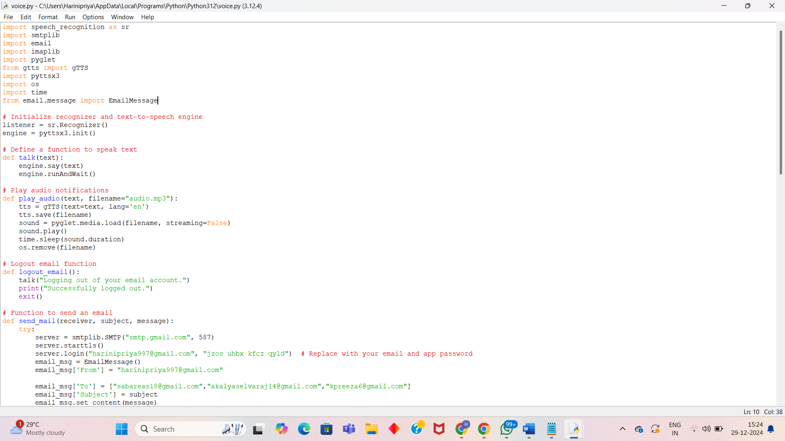

Slide 18
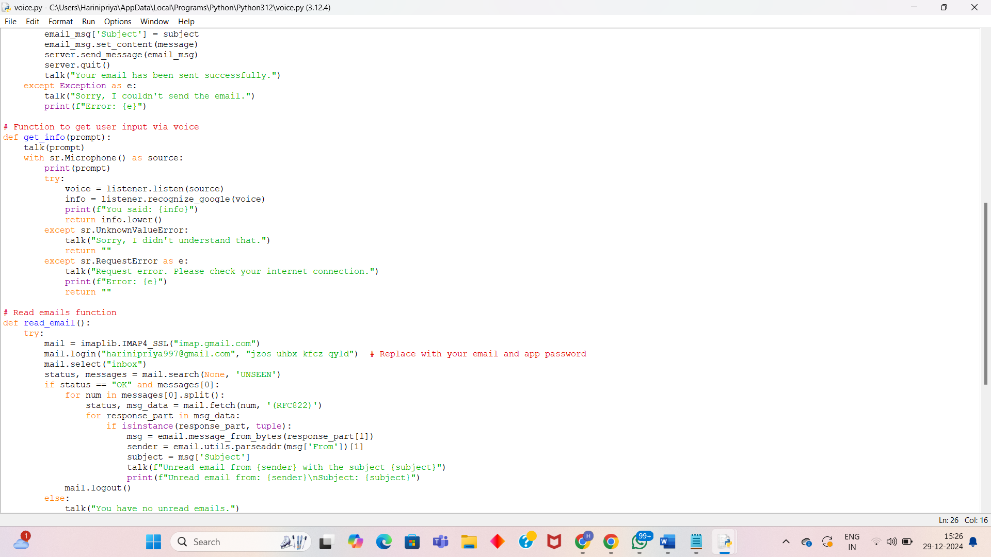

Slide 19
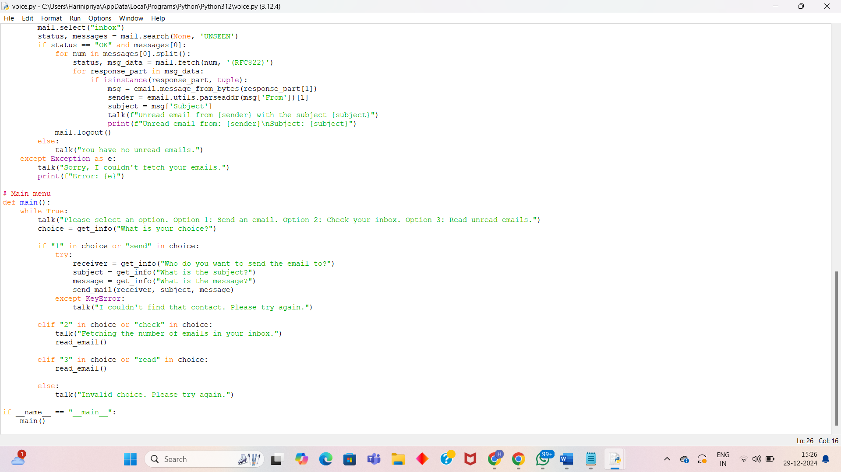

Slide 20
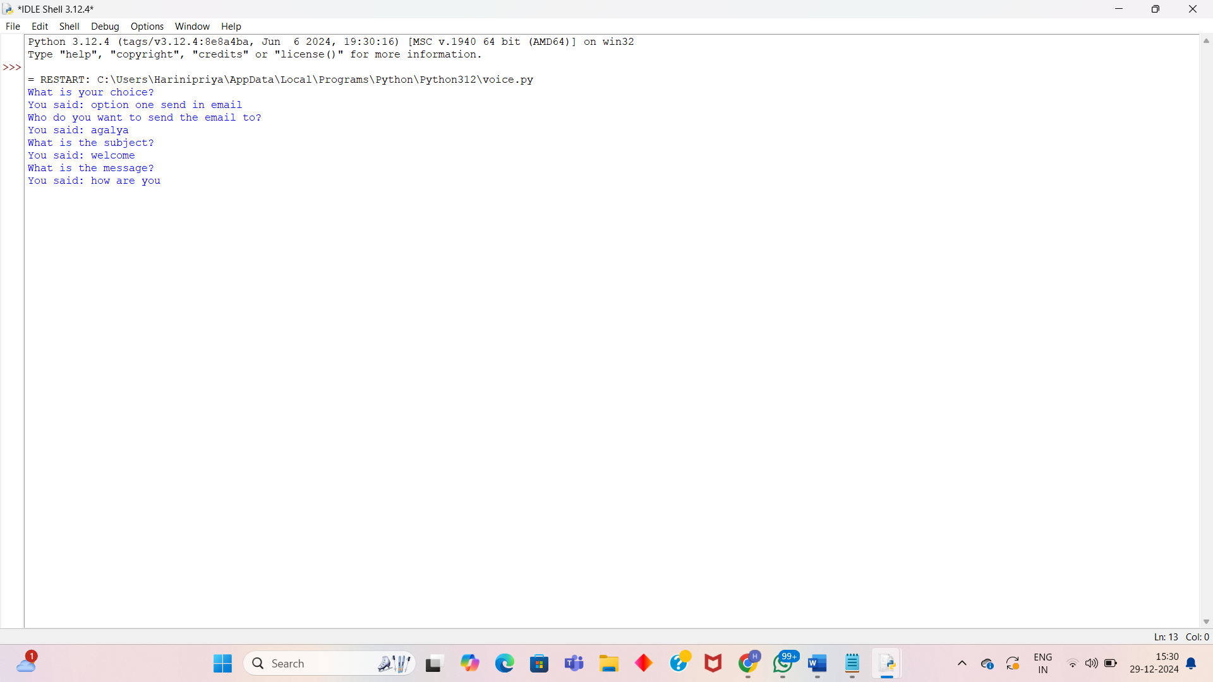
OUTPUT:

Slide 21
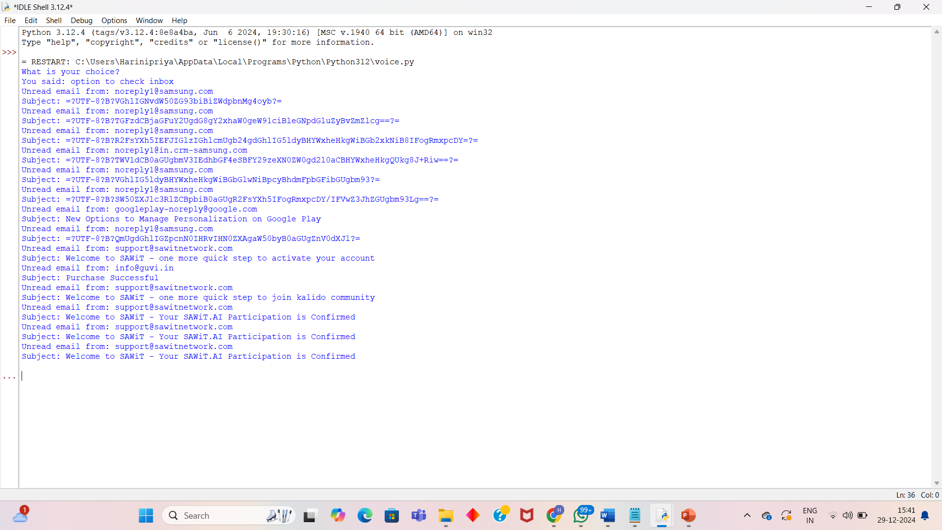

Slide 22
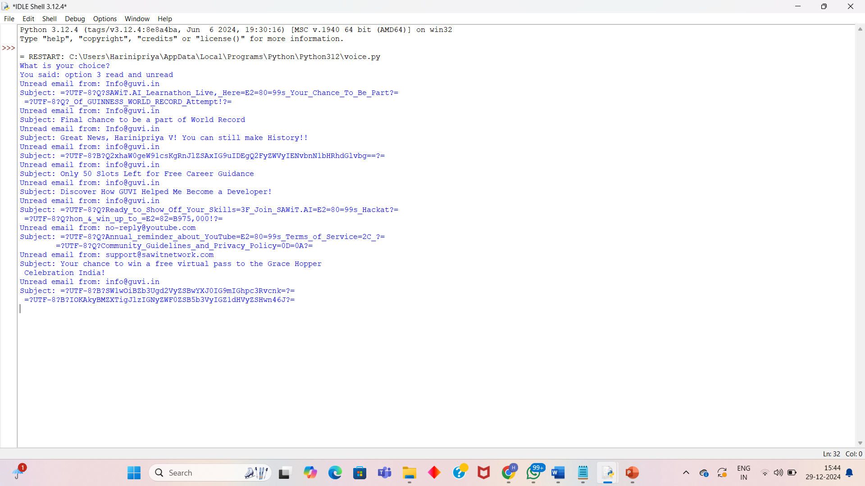

Slide 23
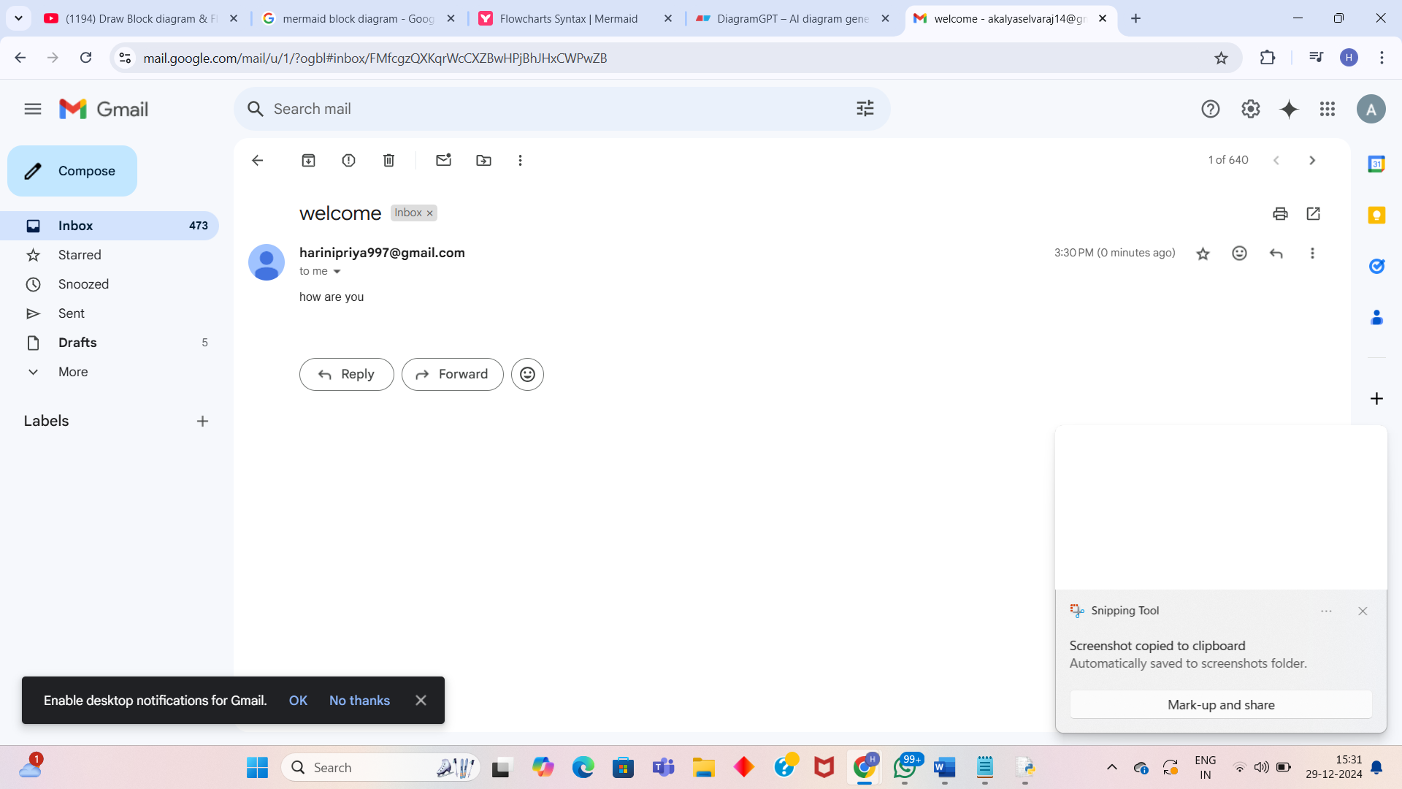
RESULT:

Slide 24
CONCLUSION:
By leveraging advanced natural language processing and speech recognition technologies, these systems enable users to compose, send, receive, and manage emails using their voice commands. They eliminate the barriers faced by visually impaired individuals when accessing and interacting with email platforms, allowing them to communicate more efficiently and effectively in the digital world. By providing a hands-free and intuitive interface, visually impaired users can navigate through their email accounts, dictate and listen to messages, and perform various email-related tasks with ease. The integration of Al enables the systems to understand and interpret natural language commands, enhancing the user experience and reducing the learning curve.

Slide 25
FUTURE SCOPE:
1)Enhanced Natural Language Processing (NLP):
Integration of advanced AI models to improve command understanding, even for diverse accents, dialects, and languages.
Implementation of context-aware responses for smoother interactions.
2)AI-Powered Smart Suggestions:
Auto-summarization of emails to save time.
Predictive text and intelligent suggestions for faster email composition.
3)Multi-Language Support:
Expanding the system to support multilingual users for wider accessibility.
Real-time translation of emails using voice commands.

Slide 26


